Slide 1

AIRBNB HOTEL BOOKING ANALYSIS
Prajwal Chavan
INTERNSHIP_17546440516895be537820f0

Slide 2

PROBLEM STATEMENT
Airbnb is a popular platform where property owners rent out their homes or apartments to travelers. One of the biggest challenges for hosts is deciding the right price for their listings, since prices vary depending on several factors such as the number of bedrooms, number of bathrooms, cleanliness, accuracy of descriptions, a communication quality with guests.

Slide 3
Project Description
This project aims to develop a machine learning model that predicts Airbnb listing prices. Accurate pricing is essential for both hosts and guests—hosts seek to optimize their revenue and occupancy rates, while travelers look for fair and competitive rates. By analyzing historical Airbnb data, the project builds a regression model that identifies how various factors such as the number of bedrooms, bathrooms, and guest ratings influence the listing price.The trained model can then estimate prices for new or potential listings, enabling property owners to set data-driven and competitive prices.

Slide 4

WHO ARE THE END USERS?
Airbnb Hosts. : To algorithmically refine the pricing strategy of their properties by leveraging correlations among structural attributes and guest feedback metrics.
Travelers : To critically assess the rationality of listed prices relative to intrinsic property characteristics and market equilibrium.
Airbnb Platform Analysts : To enhance dynamic pricing algorithms and strengthen user confidence through data-driven pricing intelligence.
Researchers/Students : To empirically investigate the quantitative influence of property attributes and user sentiment on rental price determination.

Slide 5

Technology Used
Python-Core programming languageI
Pandas & NumPy-Data cleaning and preprocessing
Scikit-learn-Machine learning (model training, regression, evaluation)-
Matplotlib/Seaborn-Data visualization and feature importance
Google Colab-Cloud-based environment for running the project
File handling libraries openpyxi (for Excel) and built-in CSV handling

Slide 6
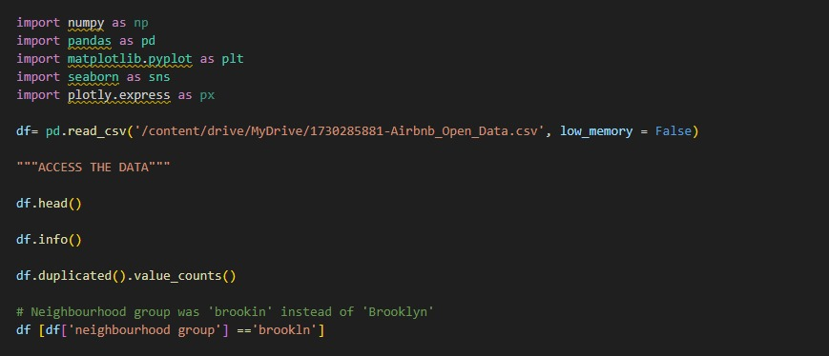
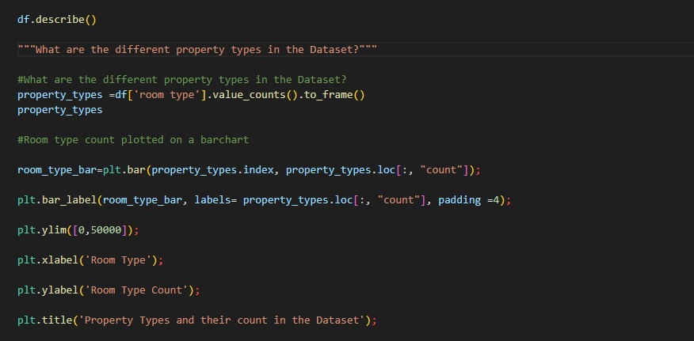
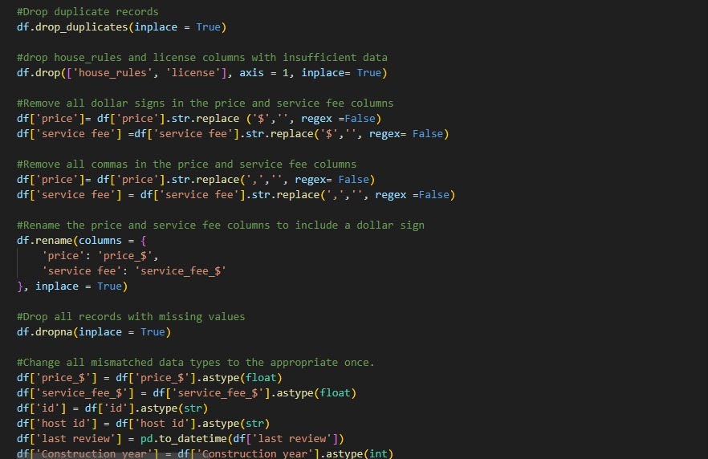
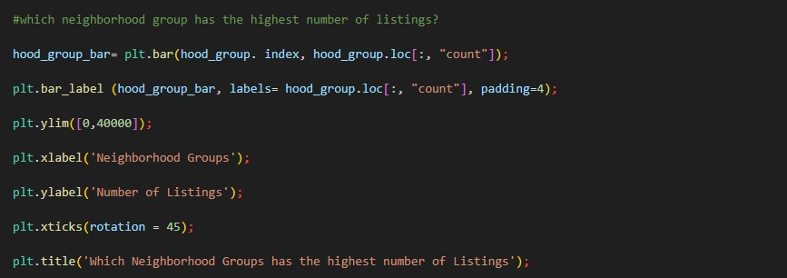
Pyhton Code

Slide 7
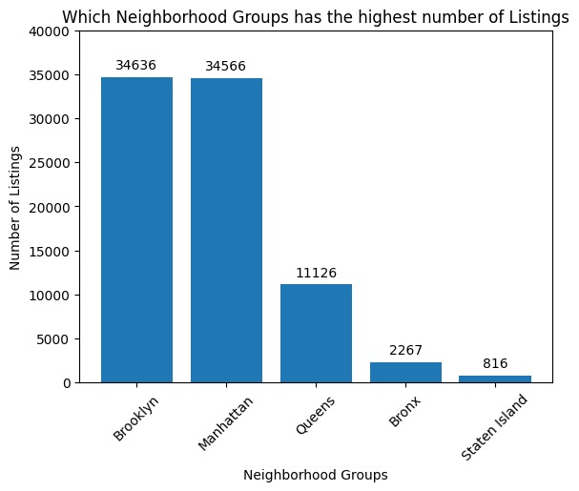
RESULT 1

Slide 8
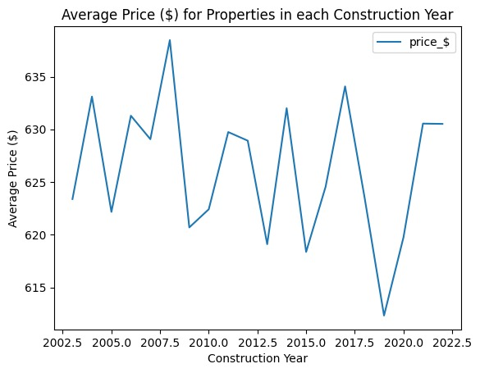
RESULT 2

Slide 9
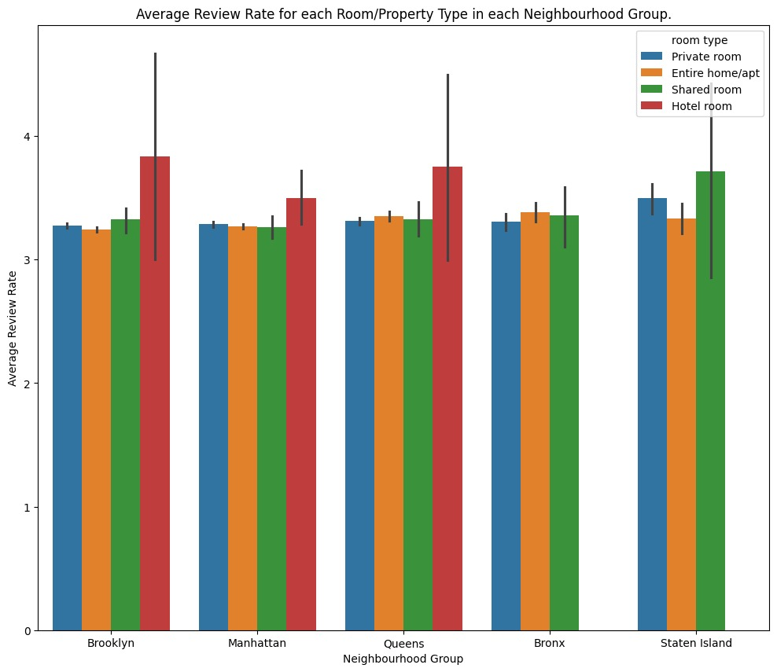
RESULT 3

Slide 10
GitHub repository
https://github.com/prajwalchavan007/VOIS_AICTE_Oct2025_PrajwalChavan.git

Slide 11
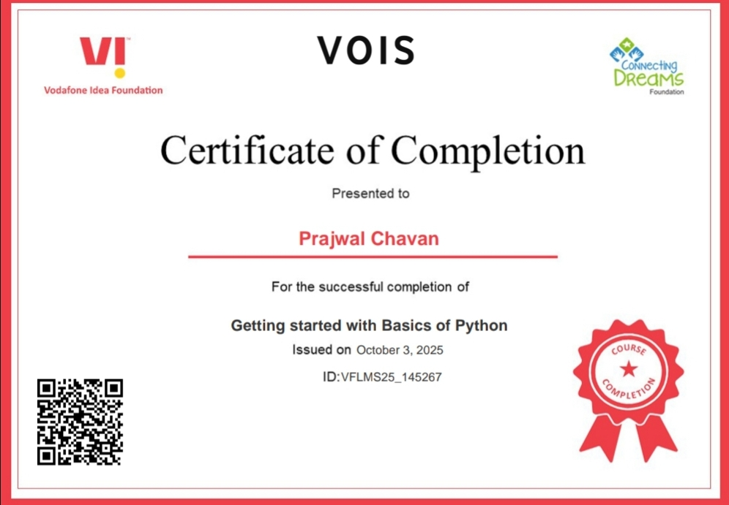
Getting started with Basics of Python Certificate

Slide 12
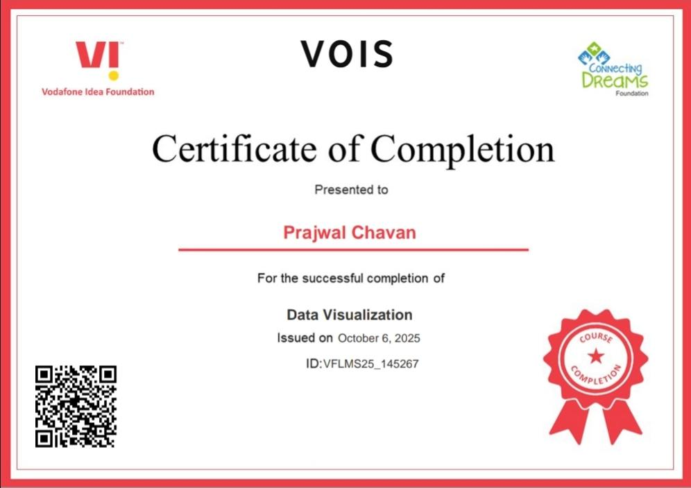
Data Visualization Certificate

Slide 13
Thank you
.
.

